Slide 1


Ryan Price
21/11/2023

Slide 2

Outline
Executive Summary
Introduction
Methodology
Results
Conclusion
Appendix

Slide 3
Executive Summary
The goal of this research is to analyse SpaceX Falcon 9 data collected through various sources and employ Machine Learning models to predict the success of first stage landing that provides other space agencies the ability to decide if they bid against SpaceX.
Summary of methodologies
Following concepts and methods were used to collect and analyse data, build and evaluate machine learning models, and make predictions:
Collect data through API and Web scraping
Transform data through data wrangling
Conduct exploratory data analysis with SQL and data visuals
Build an interactive map with folium to analyse launch site proximity
Build a dashboard to analyse launch records interactively with Plotly Dash
Finally, build a predictive model to predict if the first stage of Falcon 9 will land successfully
Summary of all results
This report will share results in various formats such as:
Data analysis results
Data visuals, interactive dashboards
Predictive model analysis results

Slide 4
Introduction
Project background and context
With the recent successes in private space travel, space industry is becoming more and more mainstream and accessible to general population. Cost of launch continues to remain a key barrier for new competitors to enter the space race
SpaceX with its first stage reuse capabilities offers a key advantage against its competitors. Each SpaceX launch costs around 62 million dollar and SpaceX can reuse stage 1 for future launches. This provides SpaceX a unique advantage where other competitors are spending around 165 mission plus for each launch
Problems you want to find answers
Determine if the first stage of SpaceX Falcon 9 will land successfully
Impact of different parameters/variables on the landing outcomes (e.g., launch site, payload mass, booster version, etc.) • Correlations between launch sites and success rates

Slide 5

Section 1

Slide 6
Methodology
Executive Summary
Data collection methodology:
Web Scrapping was used for the launch records relating to Falcon 9 and Falcon Heavy.
SpaceX API
Perform data wrangling
Created labels for training the supervised models by converting launch outcomes in to training labels: 0 – Unsuccessful & 1 – Successful.
Perform exploratory data analysis (EDA) using visualization and SQL
Perform interactive visual analytics using Folium and Plotly Dash
Perform predictive analysis using classification models
Created a column for ‘class’, standardized then transformed the data, split the data into test/train, find the most suitable classification model using test data.

Slide 7
Data Collection
Data collection is where the data that will be used is gathered from available sources. The data can be structured, unstructured or semi-structured. In this project, the data was collected using two processes; SpaceX API AND Web scraping.
SpaceX API
Web Scraping
Request launch data from SpaceX API
Read .json response and convert to a DataFrame
Extract necessary columns to suit requirements
Convert DataFrame to CSV
Request Falcon9 html using HTTP GET method
Create beautiful soup object from the HTML response
Collect relevant data to DataFrame
Convert DataFrame to CSV

Slide 8
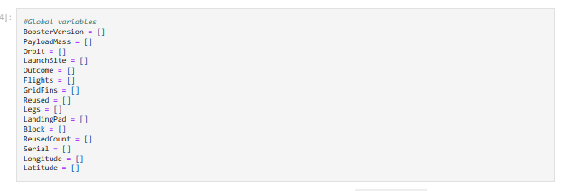
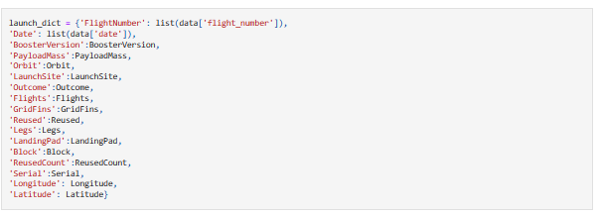
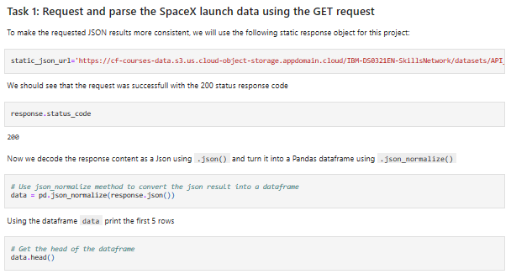
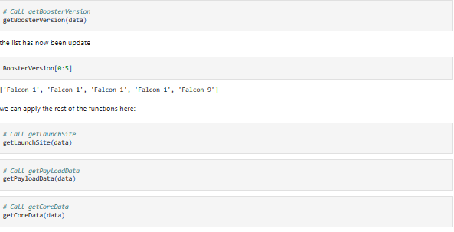
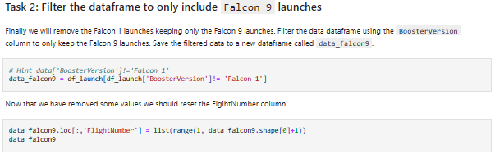
Data Collection – SpaceX API
API Request and read response into Data frame
Convert Dictionary to Data frame, filter for Falcon9 launches & convert to CSV
Declare Global Variables
Call helper functions with API calls to populate global variables
Construct data using a dictionary

Slide 9
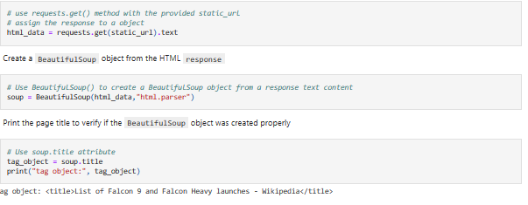
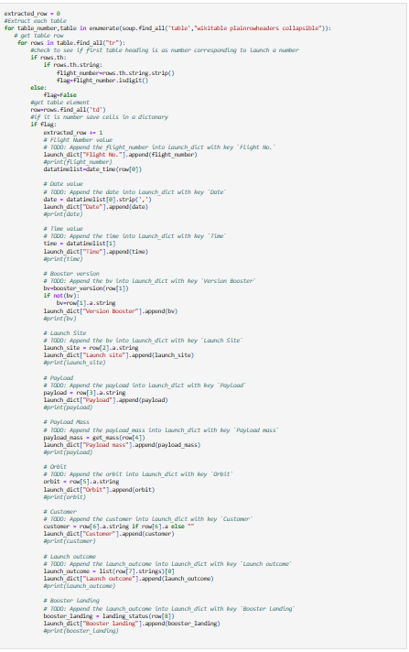
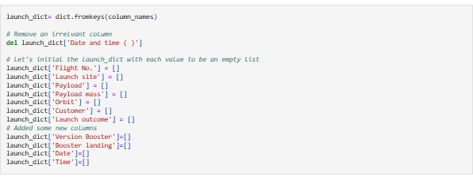
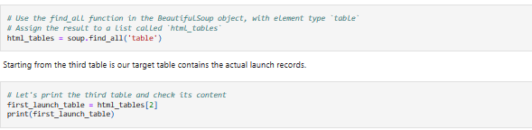
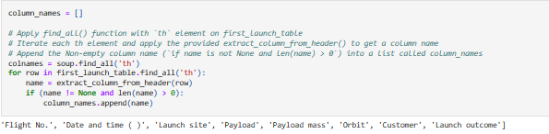
Data Collection - Scraping
Perform HTTP GET to request HTML page
Call helper functions to fill the dictionary with launch records
Create Beautiful Soup Object
Extract column names from HTML table header
Create Dictionary with keys from extracted column names
Convert Dictionary to Data Frame

Slide 10
Data Wrangling
To identify patterns and define the labels for training supervised models' exploratory data analysis was conducted.
The data set used had a variety of mission outcomes. These were converted into training labels. 1 meant that the booster was successful and 0 meant the booster was unsuccessful.
Landing scenarios considered:
True Ocean means the mission outcome was successfully landed to a specific region of the ocean
False Ocean means the mission outcome was unsuccessfully landed to a specific region of the ocean
RTLS means the mission outcome was successfully landed to a ground pad
False RTLS means the mission outcome was unsuccessfully landed to a ground pad
True ASDS means the mission outcome was successfully landed on a drone ship
False ASDS means the mission outcome was unsuccessfully landed on a drone ship

Slide 11
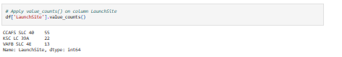
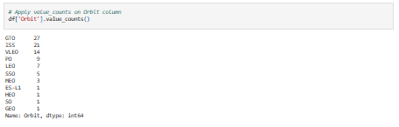
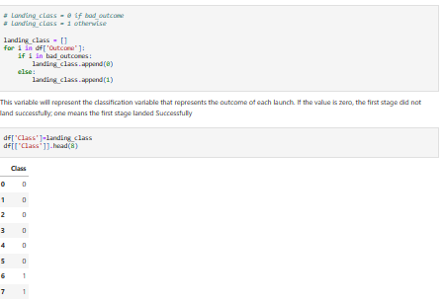
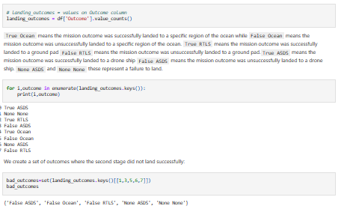
Data Wrangling
Load dataset into Data Frame
Identify patterns in the dataset
Create Landing Outcome Labels

Slide 12
EDA with Data Visualization
A plethora of charts were plotted during EDA to gain a higher degree of insights:
Scatter plot
A scatter plot shows the relationship between two variables providing visually easy patterns to observe.
Scatterplots created:
Flight Number and Launch Site
Payload and Launch Site
Flight Number and Orbit Type
Payload and Orbit Type
Bar Chart
Bar harts are commonly used when the aim is to compare values of variables at a singular point in time.
Bar charts are very easy to understand and provide a good comparison since each bar is proportional to the value of the variable it represents.
Bar Charts created:
Relationship between success rate of each orbit type
Line Chart
Best used if/when you want to track changes over a timescale. Good to visualize trends.
Line Charts created:
Average launch success yearly trend

Slide 13
EDA with SQL
SQL is very useful when manipulating data as it provides a quick and easy way to better understand the dataset.
The following SQL queries to performed on the dataset:
Display the names of the unique launch sites in the space mission
Display 5 records where launch sites begin with the string 'CCA'
Display the total payload mass carried by boosters launched by NASA (CRS)
Display average payload mass carried by booster version F9 v1.1
List the date when the first successful landing outcome in ground pad was achieved.
List the names of the boosters which have success in drone ship and have payload mass greater than 4000 but less than 6000
List the total number of successful and failure mission outcomes
List the names of the booster versions which have carried the maximum payload mass. Use a subquery
List the records which will display the month names, failure landing outcomes in drone ship ,booster versions, launch site for the months in year 2015.
Rank the count of landing outcomes (such as Failure (drone ship) or Success (ground pad)) between the date 2010-06-04 and 2017-03-20, in descending order.

Slide 14
Build an Interactive Map with Folium
Folium is a great tool to use as it allows the user to analyse geospatial data to create more interactive visuals. It also provides the user with to better understand factors such as location and proximity.
Following map object were created and added to the map:
Mark all launch sites on the map. This allowed to visually see the launch sites on the map.
Added ‘folium.circle’ and ‘folium.marker’ to highlight circle area with a text label over each launch site.
Added a ‘MarkerCluster()’ to show launch success (green) and failure (red) markers for each launch site.
Calculated distances between a launch site to its proximities (e.g., coastline, railroad, highway, city)
Added ‘MousePosition() to get coordinate for a mouse position over a point on the map
Added ‘folium.Marker()’ to display distance (in KM) on the point on the map (e.g., coastline, railroad, highway, city)
Added ‘folium.Polyline()’ to draw a line between the point on the map and the launch site •
Repeated steps above to add markers and draw lines between launch sites and proximities – coastline, railroad, highway, city)
Building the Interactive Map with Folium helped answered following questions:
Are launch sites in close proximity to railways? YES
Are launch sites in close proximity to highways? YES
Are launch sites in close proximity to coastline? YES
Do launch sites keep certain distance away from cities? YES

Slide 15
Build a Dashboard with Plotly Dash
Built a Plotly Dash web application to perform interactive visual analytics on SpaceX launch data in real-time. Added Launch Site Drop-down, Pie Chart, Payload range slide, and a Scatter chart to the Dashboard.
Added a Launch Site Drop-down Input component to the dashboard to provide an ability to filter Dashboard visual by all launch sites or a particular launch site
Added a Pie Chart to the Dashboard to show total success launches when ‘All Sites’ is selected and show success and failed counts when a particular site is selected
Added a Payload range slider to the Dashboard to easily select different payload ranges to identify visual patterns
Added a Scatter chart to observe how payload may be correlated with mission outcomes for selected site(s). The colour-label Booster version on each scatter point provided missions outcomes with different boosters
Dashboard helped answer following questions:
Which site has the largest successful launches? KSC LC-39A with 10
Which site has the highest launch success rate? KSC LC-39A with 76.9% success
Which payload range(s) has the highest launch success rate? 2000 – 5000 kg
Which payload range(s) has the lowest launch success rate? 0-2000 and 5500 - 7000
Which F9 Booster version (v1.0, v1.1, FT, B4, B5, etc.) has the highest launch success rate? FT

Slide 16
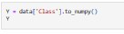
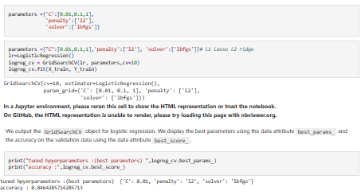
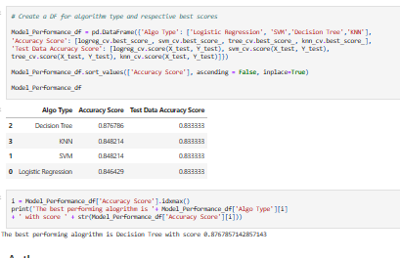
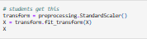
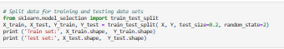
Predictive Analysis (Classification)
Read dataset into Data Frame and create an array
Standardize the data
Split data in to training and test data sets
Create and Refine models
Find the best performing model

Slide 17
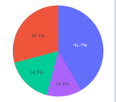
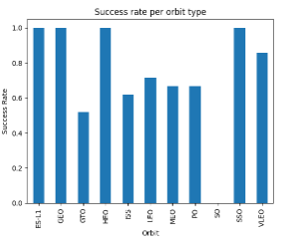
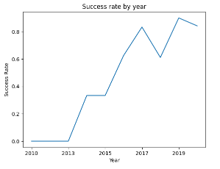
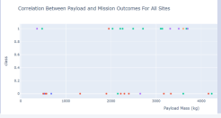
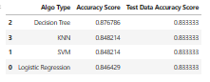
Results
Exploratory Data Analysis
Interactive Analytics Demo
Predictive Analysis Results

Slide 18

Section 2

Slide 19
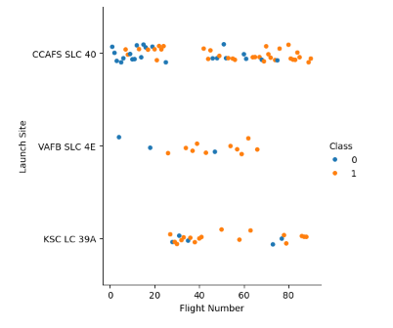
Flight Number vs. Launch Site
The mission success rate increases as the number of flights increase.
For Launch Site CCAFS SLC40 it takes around 10 launches before a successful launch.
For VAFB SLC 4E and KSC LC 39A it takes around 20 launches until a successful launch.

Slide 20
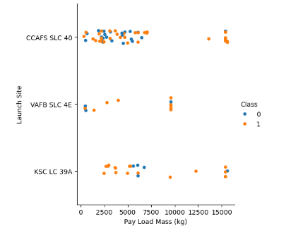
Payload vs. Launch Site
For launch site ‘VAFB SLC 4E’, there are no rockets launched for payload greater than 10,000 kg
Percentage of successful launch (Class=1) increases for launch site ‘VAFB SLC 4E’ as the payload mass increases
There is no clear correlation or pattern between launch site and payload mass

Slide 21
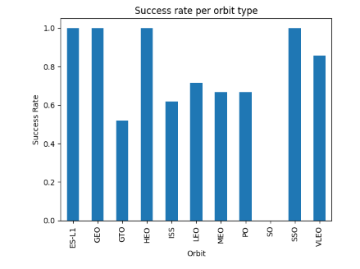
Success Rate vs. Orbit Type
Orbits ES-LI, GEO, HEO, and SSO have the highest success rates
GTO orbit has the lowest success rate

Slide 22
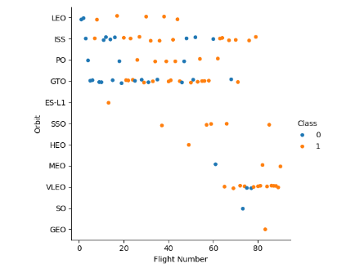
Flight Number vs. Orbit Type
For orbit VLEO, first successful landing (class=1) doesn’t occur until 60+ number of flights
For most orbits (LEO, ISS, PO, SSO, MEO, VLEO) successful landing rates appear to increase with flight numbers
There is no relationship between flight number and orbit for GTO

Slide 23
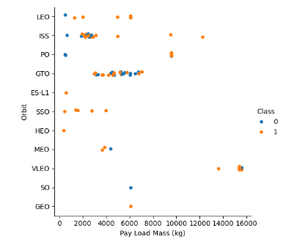
Payload vs. Orbit Type
Successful landing rates (Class=1) appear to increase with pay load for orbits LEO, ISS, PO, and SSO
For GEO orbit, there is not clear pattern between payload and orbit for successful or unsuccessful landing

Slide 24
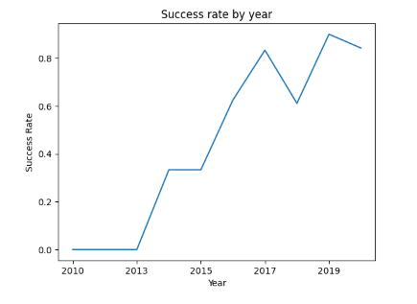
Launch Success Yearly Trend
Success rate (Class=1) increased by about 80% between 2013 and 2020
Success rates remained the same between 2010 and 2013 and between 2014 and 2015
Success rates decreased between 2017 and 2018 and between 2019 and 2020

Slide 25
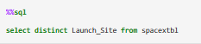
All Launch Site Names
Query:
Description:
The SQL query will return a unique list of launch Site in the spacextbl table.
There are 4 unique Launch Sites
Output:
launch_site
CCAFS LC-40
CCAFS SLC-40
KSC LC-39A
VAFB SLC-4E

Slide 26
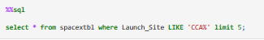
Launch Site Names Begin with 'CCA'
Query:
Output:
Date | Time (UTC) | Booster_Version | Launch_Site | Payload | PAYLOAD_MASS__KG_ | Orbit | Customer | Mission_Outcome | Landing_Outcome
2010-06-04 | 18:45:00 | F9 v1.0 B0003 | CCAFS LC-40 | Dragon Spacecraft Qualification Unit | 0 | LEO | SpaceX | Success | Failure (parachute)
2010-12-08 | 15:43:00 | F9 v1.0 B0004 | CCAFS LC-40 | Dragon demo flight C1, two CubeSats, barrel of Brouere cheese | 0 | LEO (ISS) | NASA (COTS) NRO | Success | Failure (parachute)
2012-05-22 | 7:44:00 | F9 v1.0 B0005 | CCAFS LC-40 | Dragon demo flight C2 | 525 | LEO (ISS) | NASA (COTS) | Success | No attempt
2012-10-08 | 0:35:00 | F9 v1.0 B0006 | CCAFS LC-40 | SpaceX CRS-1 | 500 | LEO (ISS) | NASA (CRS) | Success | No attempt
2013-03-01 | 15:10:00 | F9 v1.0 B0007 | CCAFS LC-40 | SpaceX CRS-2 | 677 | LEO (ISS) | NASA (CRS) | Success | No attempt
Description:
Returns everything from the spacextbl where the launch site starts with CCA and limits the output to 5 rows.

Slide 27
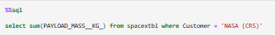
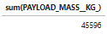
Total Payload Mass
Query:
Description:
Sums the payload mass where the customer is equal to NASA (CRS)
Output

Slide 28
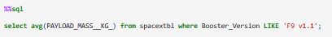
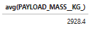
Average Payload Mass by F9 v1.1
Query:
Description:
Returns the average payload mass where the booster version is ‘F9 v1.1’
Output

Slide 29
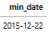
First Successful Ground Landing Date
Query:
Description:
Min date selects the first/oldest date from the ‘Date’ column
Returns the first successful landing outcome where the landing outcome is equal to ‘Success (ground pad)’.
Output:

Slide 30
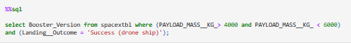
Successful Drone Ship Landing with Payload between 4000 and 6000
Query:
Description:
Query returns all booster versions where the payload mass is greater than 4000 and less than 6000 and the landing outcome is successful in drone ship.
Output:
booster_version
F9 FT B1022
F9 FT B1026
F9 FT B1021.2
F9 FT B1031.2

Slide 31
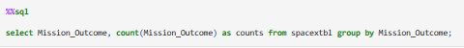
Total Number of Successful and Failure Mission Outcomes
Query:
Description:
The query will group the output by Mission_Outcome and then count the mission outcomes.
This will return the distinct mission outcomes and a count of them.
Output:
mission_outcome | counts
Failure (in flight) | 1
Success | 99
Success (payload status unclear) | 1

Slide 32
Boosters Carried Maximum Payload
Query:
Description:
This query includes a subquery. The sub query returns the maximum payload mass by using keyword max on the pay load mass column. In this case, 15600kg.
Therefore, the main query is going to return booster_version and the payload mass where it is equal to 15600kg.
Output:
booster_version | payload_mass__kg_
F9 B5 B1048.4 | 15600
F9 B5 B1049.4 | 15600
F9 B5 B1051.3 | 15600
F9 B5 B1056.4 | 15600
F9 B5 B1048.5 | 15600
F9 B5 B1051.4 | 15600
F9 B5 B1049.5 | 15600
F9 B5 B1060.2 | 15600
F9 B5 B1058.3 | 15600
F9 B5 B1051.6 | 15600
F9 B5 B1060.3 | 15600
F9 B5 B1049.7 | 15600

Slide 33
2015 Launch Records
Query:
Description:
Returns a list of Landing Outcomes, Booster Version and Launch Sites where the landing outcome is equal to Failure (drone ship) and the year is 2015.
Output:
Landing_Outcome | Booster_Version | Launch_Site
Failure (drone ship) | F9 v1.1 B1012 | CCAFS LC-40
Failure (drone ship) | F9 v1.1 B1015 | CCAFS LC-40

Slide 34
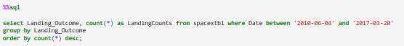
Rank Landing Outcomes Between 2010-06-04 and 2017-03-20
Query:
Description:
The ‘group by’ key word arranges data in column ‘Landing__Outcome’ into groups
The ‘between’ and ‘and’ keywords return data that is between 2010-06-04 and 2017-03-20
The ‘order by’ keyword arranges the counts column in descending order
The result of the query is a ranked list of landing outcome counts per the specified date range
Output:
Landing_Outcome | LandingCounts
No attempt | 10
Success (drone ship) | 5
Failure (drone ship) | 5
Success (ground pad) | 3
Controlled (ocean) | 3
Uncontrolled (ocean) | 2
Failure (parachute) | 2
Precluded (drone ship) | 1

Slide 35

Section 3

Slide 36
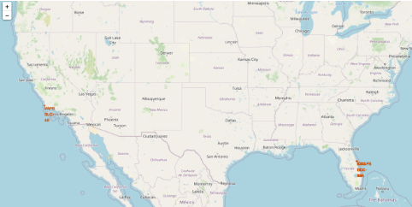
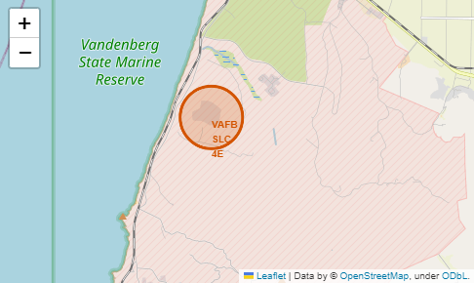
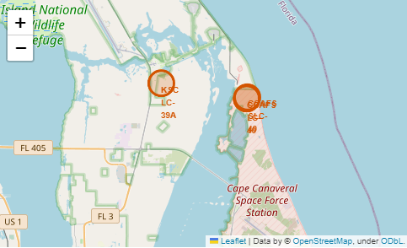
SpaceX Falcon9 – Launch Sites
Fig 2
Fig 1
Figure 1 shows the global map with the Falcon9 launch sites.
Each launch site has a circle, label and, a popup to highlight the locations.
Figures 2 and 3 zoom in to the specific locations:
VAFB SLC-4E
CCAFS LC-40
KSC LC-39A
CCAFS SLC-40
Fig 3

Slide 37
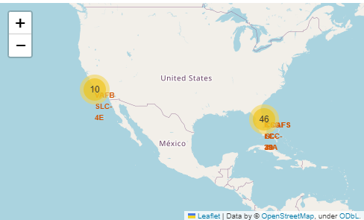
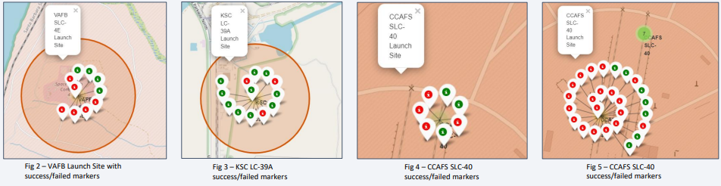
SpaceX Falcon9 – Success/Failed Launches
Figure 1 shows the global map with the launch sites highlighted. The numbers on the map show the number of successful/failed launches.
Figures 2.3.4 and 5 are zoomed in snippets of the figure 1 and they show the success/fail markers with green as success and red as failed.
The map suggests that the launch site, KSC LC 39-A has the most successful launches.

Slide 38
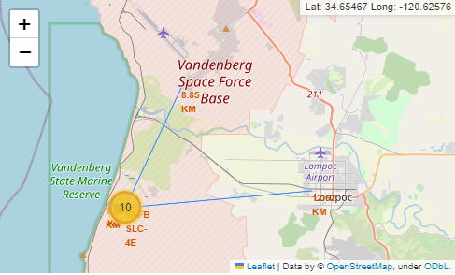
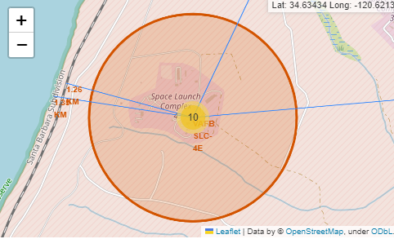
SpaceX Falcon9 – Proximity Maps
Fig 1
Fig 2
Figure 1 displays all the proximity sites marked on the map for Launch Site VAFB SLC-4E. City Lompoc is located further away from Launch Site compared to other proximities such as coastline, railroad, highway, etc. The map also displays a marker with city distance from the Launch Site (14.09 km)
Figure 2 provides a zoom in view into other proximities such as coastline, railroad, and highway with respective distances from the Launch Site
In general, cities are located away from the Launch Sites to minimize impacts of any accidental impacts to the public and infrastructure. Launch Sites are strategically located near the coastline, railroad, and highways to provide easy access to resources

Slide 39

Section 4

Slide 40
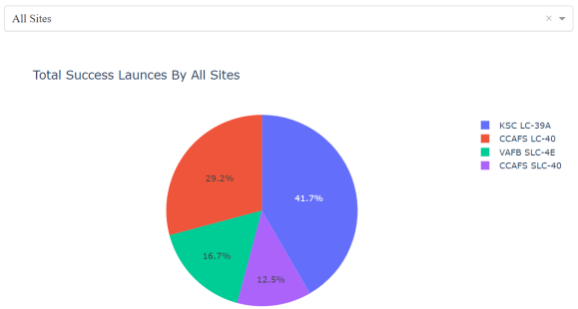
Launch Success Counts
The combined success rate of CCAFS SLC-40 and VAFB SLC-4E is still not as high as the success rate of KSC LC-39A
KSC LC-39A has the highest launch success percentage.
CCAFS SLC-40 has the lowest launch success percentage

Slide 41
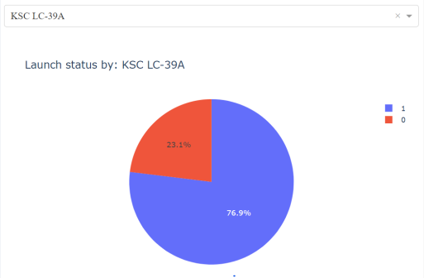
Launch Site with Highest Launch Success Ratio
As seen in the previous slide, KSC LC-39A has the highest launch success rate and count.
KSC LC-39A has a launch failure rate of 23.1%
Launch Success rate is 76.9%

Slide 42
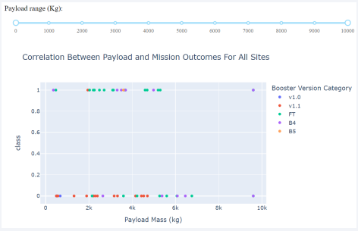

Payload vs. Launch Outcome Scatter Plot
Payload ranges from 2000-5500 seem to offer best chances of a successful launch.
The booster version category ‘FT’ has the most successful launches.
‘B4’ is the only booster with a successful launch when the payload is more than 6000.

Slide 43

Section 5

Slide 44
Classification Accuracy
The algorithm that offers the highest classification score is the Decision Tree with a value of .876786.
The Test Data Accuracy Score is the same for all algorithms.
 | Algo Type | Accuracy Score | Test Data Accuracy Score
2 | Decision Tree | 0.876786 | 0.833333
3 | KNN | 0.848214 | 0.833333
1 | SVM | 0.848214 | 0.833333
0 | Logistic Regression | 0.846429 | 0.833333

Slide 45

Confusion Matrix
The confusion matrix is same for all the models (LR, SVM, Decision Tree, KNN)
Per the confusion matrix, the classifier made 18 predictions
12 scenarios were predicted Yes for landing, and they did land successfully (True positive)
3 scenarios (top left) were predicted No for landing, and they did not land (True negative)
3 scenarios (top right) were predicted Yes for landing, but they did not land successfully (False positive)
Overall, the classifier is correct about 83% of the time ((TP + TN) / Total) with a misclassification or error rate ((FP + FN) / Total) of about 16.5%

Slide 46
Conclusions
The first stage of the launch is more likely to land successfully as the number of flights increase.
There is no clear correlation between Payload Mass and success rates. However, they do appear to go up as payload increases.
From 2013 to 2020 launch success rate increased by around 80%.
Launch Site ‘CCAFS SLC-40’ has the lowest launch success rate.
Launch Site ‘KSC LC-39A’ has the highest launch success rate.
Orbit GTO has the lowest launch success rate.
Launch Sites appear to be located strategically near coastlines, railroads and highways whilst being a fair distance from cities.
The best performing Machine Learning Classfication Model is the Decision Tree with an accuracy of about 87.5%. When the models were scored on the test data, the accuracy score was about 83% for all models.

Slide 47
Appendix
Include any relevant assets like Python code snippets, SQL queries, charts, Notebook outputs, or data sets that you may have created during this project

Slide 48


